Slide 1
TRAINLAB-AUTOMATIC MODEL ANALYSER & TRAINER
SIVASHANKAR S (210701252)
SAI PRASAD R (210701220)

Slide 2
” WHY
THIS
PROJECT..?”

Slide 3
PROJECT INTRODUCTION

Slide 4
01 - PROJECT FLOW
Inspecting the workflow of the proįect
02 - EXPLANATION
Explaining the proįect flow
03 - CODE REVIEW
Articulating the proįect's technical intricacies at the code level

Slide 5
PROJECT FLOW
Upload dataset
Choosing ML type
Model Training
2
4
6
1
3
5
7
Gathering a dataset
Download
Dataset preprocessing
Analysing data

Slide 6
EXPLANATION

Slide 7


GATHERING A DATASET
Obtaining a collection of data from various sources, including databases, APIs, or manual data entry, to serve as the foundation for machine learning tasks.

Slide 8



UPLOADING THE DATASET
Providing a user-friendly interface to allow users to upload their datasets into the machine learning environment, facilitating seamless access and integration of data for analysis and modeling.

Slide 9



DATA PREPROCESSING
Implementing a series of data cleaning, transformation, and normalization techniques to prepare the dataset for analysis and modeling. This involves handling missing values, encoding categorical variables, scaling numerical features, and other data preprocessing tasks.

Slide 10
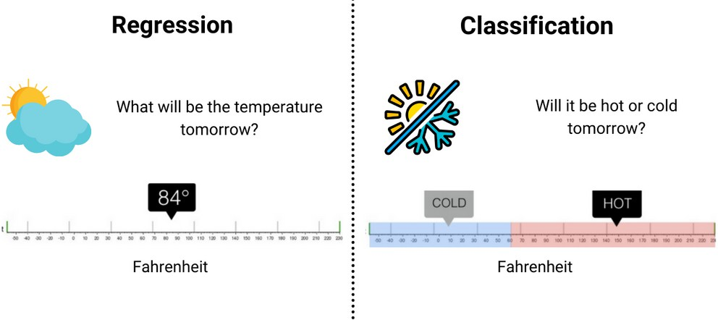
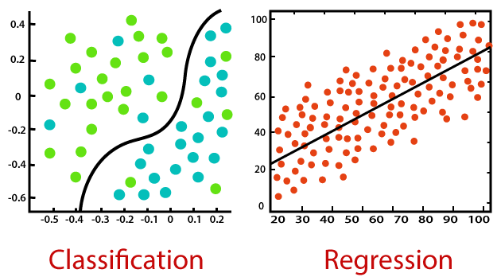
CHOOSING ML TYPE
Determining the appropriate machine learning approach based on the nature of the problem and the characteristics of the dataset. This involves selecting between regression, classification, clustering, or other specialized ML techniques to achieve the desired outcome.

Slide 11


ANALYSING DATA
Conducting exploratory data analysis (EDA) to gain insights into the dataset's characteristics.

Slide 12

MODEL TRAINING
Utilizing machine learning algorithms to build predictive models based on the preprocessed dataset. This involves selecting the appropriate model, training it on the data, tuning hyperparameters, and evaluating its performance using relevant metrics.

Slide 13


DOWNLOAD
Providing users with the ability to download trained models, for further offline use or deployment in production environments.

Slide 14
CODE REVIEW

Slide 15
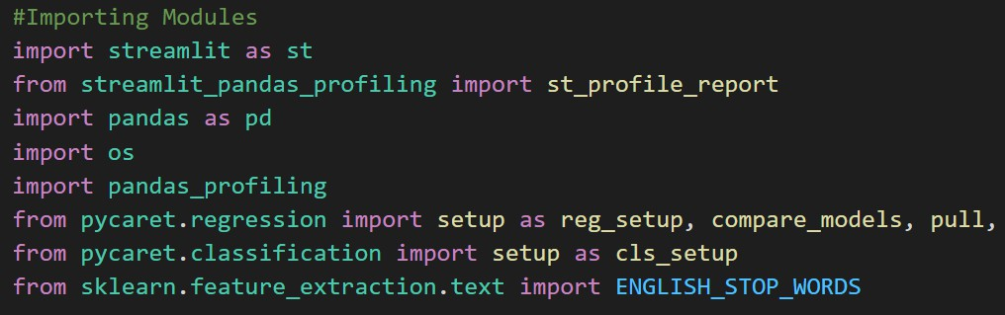
IMPORTING MODULES
save_model

Slide 16
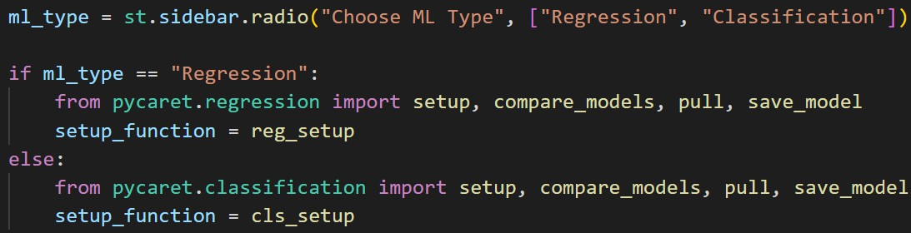
SELECTING ML TYPE

Slide 17
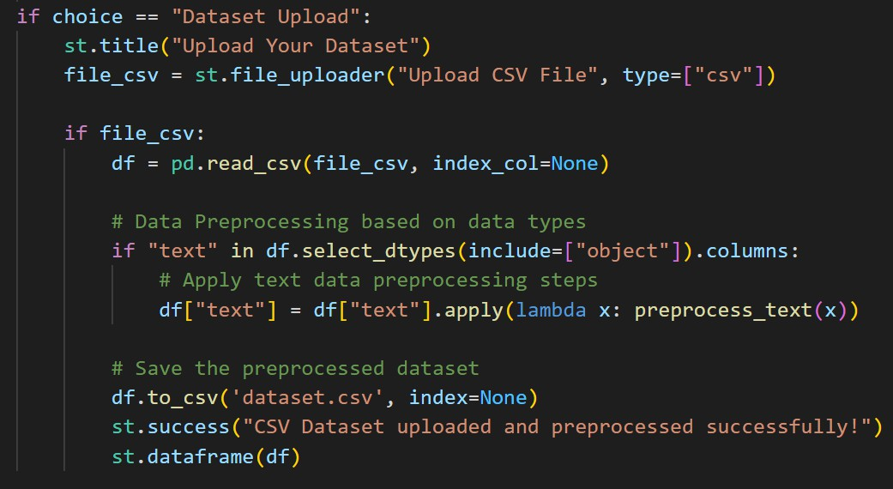
UPLOADING DATASET

Slide 18
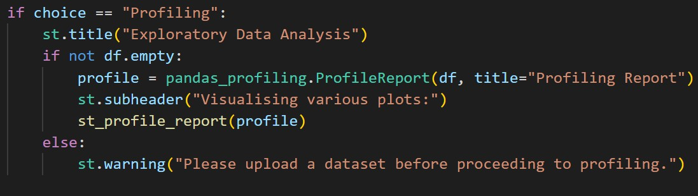
EXPLORATORY DATA ANALYSIS ~ EDA

Slide 19
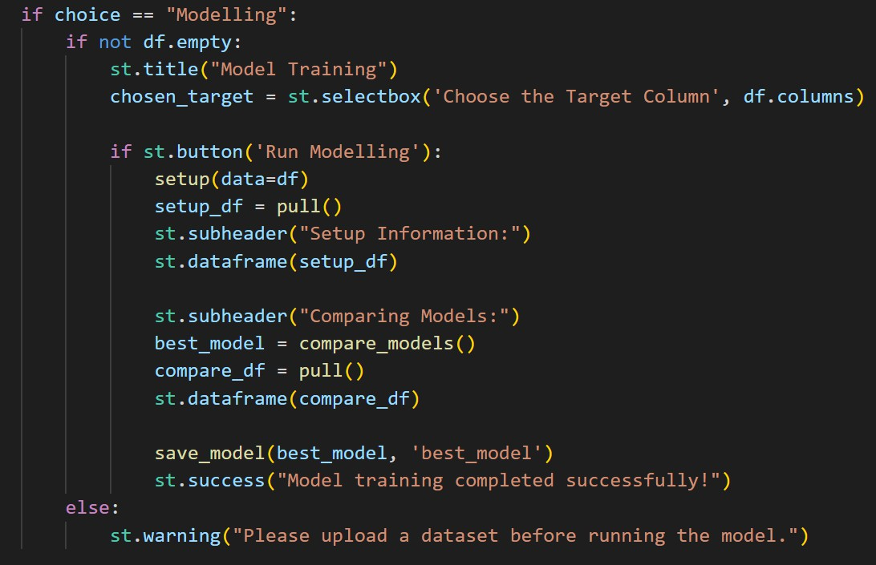
MODELLING

Slide 20
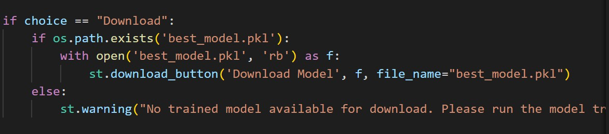
DOWNLOAD THE MODEL

Slide 21
THANK YOU

